Slide 1
EA Project
ITP4511
Developing a prototype of an Enterprise System

Slide 2
Background
Establishment of HKITI (Hong Kong Information Technology Institute)
Rebranding and upgrade of the IT department from IPE (Hong Kong Institute of Professional Education)
Before the establishment of HKITI, each IT department of IPE (5 operating campuses) manage their own resource.
Therefore, there are needs to consolidate the resource to enhance effectiveness for the use of resource (e.g., hardware equipment)

Slide 3
Driving Question
How can we design and implement a centralised equipment management system for the HKITI that effectively consolidates and optimises the utilisation of IT resources across all five Hong Kong Institute of Professional Education (IPE) campuses, while ensuring ease of access and accountability?

Slide 4
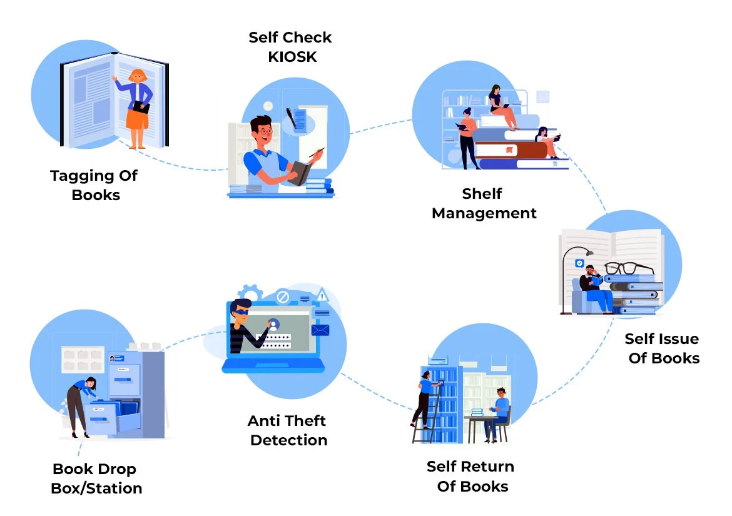
Example
A library system:

Slide 5
Discussion
What are the pros and cons centralised ystem vs Individual System for managing resource?

Slide 6
Discussion
What parties will be involved in this system?

Slide 7
Discussion
What process should can be handled through this system?

Slide 8
Discussion
What Data will be handled in this system?

Slide 9
Discussion
How’s the architectural design of the system?

Slide 10
Project Requirement
Develop a prototype for the proof of concept of the proposed system using Java EE / Jakarta EE technologies.
Contributes to 30% of the overall marks (50% of EA marks)
Group size: 2 people
Deliverables
Source code + demonstration
Report
Deadline: 22~29 Apr, 2024 (Present) & 29 Apr 2024 (Submission of Materials)

